Slide 1
Welcome 6th Graders!!
Find a seat at any BLACK table
Get a blank card and a few colors from the BROWN table to decorate your NAME CARD
Take out your schedule and agenda

Slide 2

The Bailey Way
“Greatness is a Choice”
6th grade Orientation

Slide 3

Welcome to Bailey Middle School

Slide 4
About me…
Teachers add their own information

Slide 5
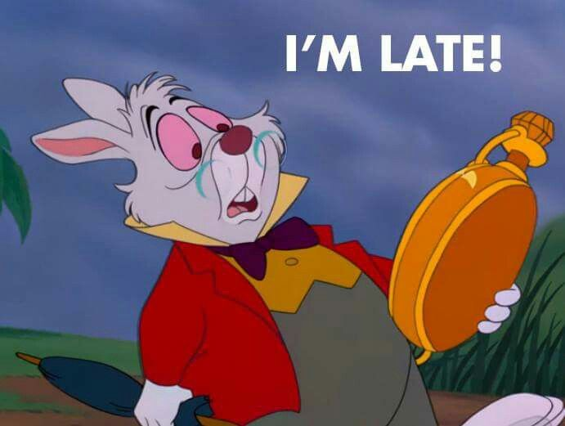
General Information
School Hours are 9:15 a.m.- 4:15 p.m.
Students may arrive no earlier than 8:45 a.m. (unless asked to do so by a teacher)
All students receive FREE “Grab and Go” breakfast
Go to your locker upon arrival and get items for your first two blocks
No “hanging out” in halls or restrooms – report directly to class
Announcements begin at 9:10 a.m.
Be on time to classes or you will be locked out! You may enter with a pass. If you do not have a pass you will receive a signature.
You must be signed out by 3:30 p.m. if you are going home early

Slide 6
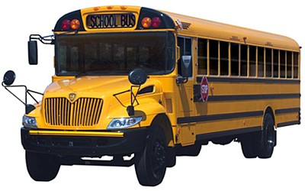
Transportation
Do you know your afternoon bus SLOT?
Your bus number may change, but your bus SLOT will always stay the same!
Riding the bus is a PRIVELEGE NOT A RIGHT – You will be suspended from the bus for inappropriate behavior
Always sit in your ASSIGNED seat
Follow all school rules (ex. no cursing, keep your hands to yourself, etc.)
No picture taking or videotaping
Talk quietly
Follow the bus drivers directions the 1st time – Always be respectful!
Your grade level Admin will come help with transportation each morning
All changes in your transportation throughout the year must be approved by your administrator

Slide 7

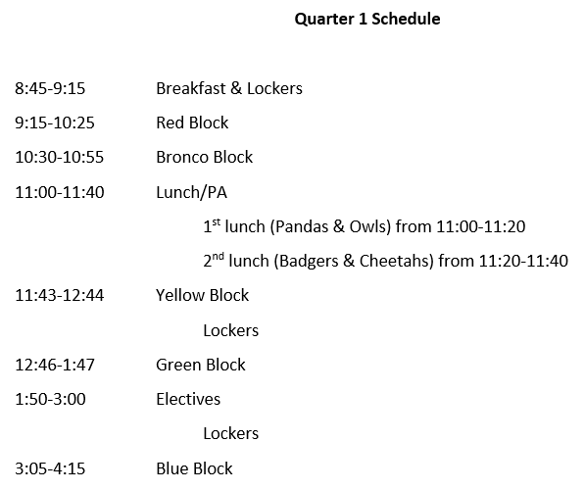
Daily Schedule – no changes week 1

Slide 8
Class Rules and Procedures
Teachers add their own information

Slide 9
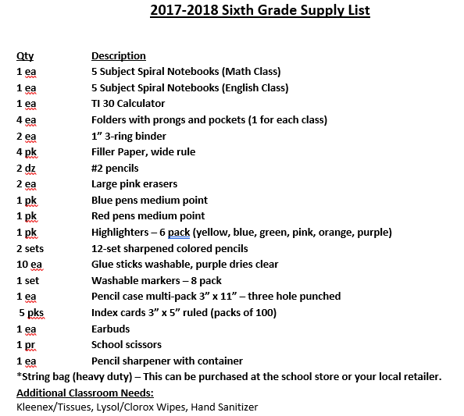

Slide 10
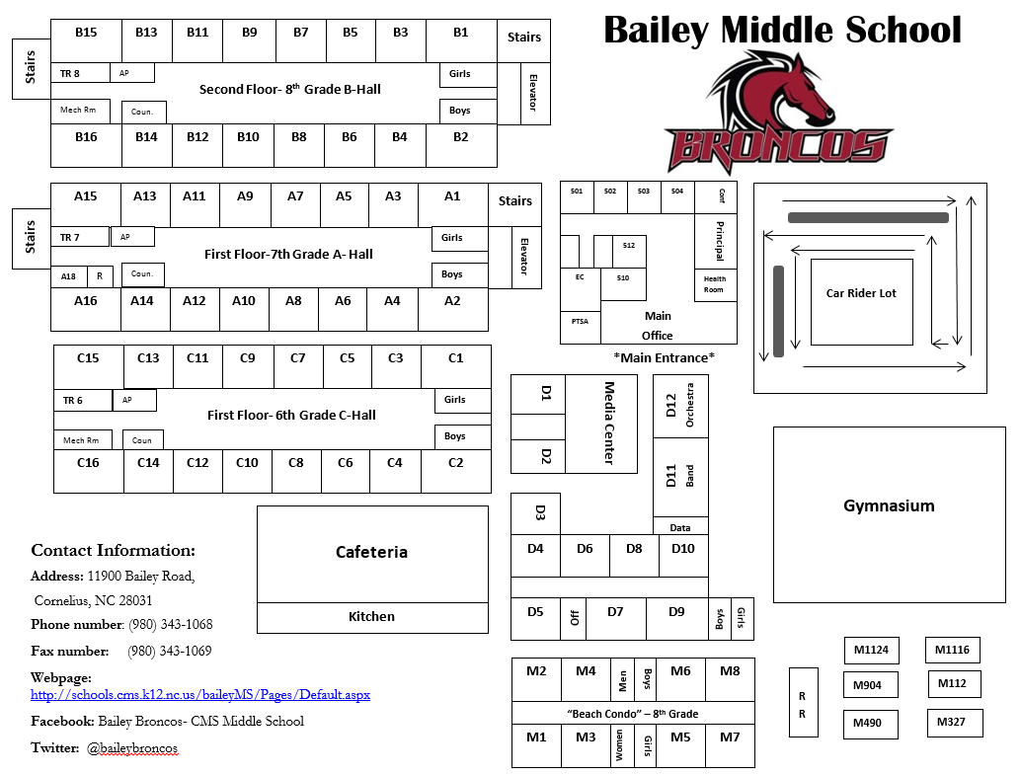
School Map

Slide 11
Transitions
This is your time to use the restroom
Visit your locker only at assigned times
Go directly to class record homework in your agenda
Begin your class “Warm Up”
6th graders will bring their instruments from band/orchestra to their last block so they already have them for dismissal

Slide 12
Electives
TEACHER | COURSE | LOCATION
Acevado | Spanish | Mobile 1116
Applegarth | Spanish | Mobile 1112
B. Myers | Orchestra | D12
Baez | CTE | D6
Bernard | Journalism/Yearbook | Mobile 327
Coldiron | Chorus | D5
Ford | PE | Gym
Hodge | CTE | D4
Kendrick | CTE | Mobile 1124
Klingman | Drama | D7
LaRotonda | Health/PE | Gym
Lester | CTE | D10
Martin | Health | Gym
Meyer, P. | ESL | B9 (8th grade hall upstairs)
Petersen | Band | D11
Reiss | Art | B16 (8th grade hall upstairs)
Riehl | Health/PE | Gym
Riley | Dance | D9
Smith-Carty | Spanish | Mobile 904
Wall | CTE | D8
Wazaney | Journalism/Yearbook | Media Center
Weir | Art | D3

Slide 13

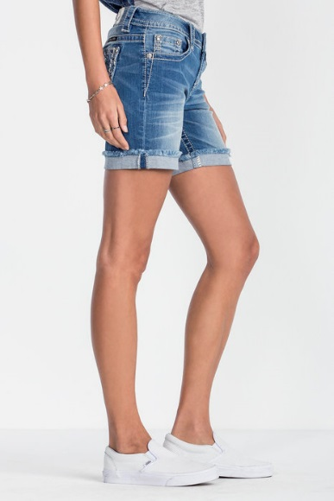
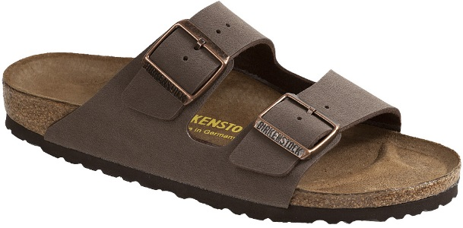
Dress Code
Clothing or jewelry with abusive, suggestive or profane language, symbols of illegal drugs / weapons, or any other words, symbols or slogans that disrupt the learning environment.
Bedroom shoes/clothing, flip flops, slides.
Pants worn below the waist or showing clothing beneath the main outerwear.
Shorts/skirts shorter than mid-thigh length.
Any clothing exposing the stomach, being excessively tight, see-through, low- cut or showing undergarments should not be worn.
Sleeveless tops or tank tops
Headgear (scarves, bandannas, sweatbands, stocking caps, hats, sunglasses, doo-rags and combs).
Student dress or grooming that is substantially and materially disruptive to the learning environment or to student health or safety is prohibited.

Slide 14
Bailey Behavior Plan
Throughout the week all students carry a colored behavior sheet and only receive signatures if they are breaking one of the rules.
Each week your homeroom teacher reviews the amount of signatures you received and provides a new colored behavior sheet and consequences based on the signature count.
“ACE” Rewards are randomly provided throughout the year by school administration and PTSA in recognition of positive behavior.
Behavior sheets should be reviewed and signed by parents every Thursday evening so that you can celebrate your good behavior discuss signatures.
Students are HIGHLY encouraged to staple their behavior sheet in their agenda so they do not lose it.
The rules are simple and easy to follow ☺

Slide 15
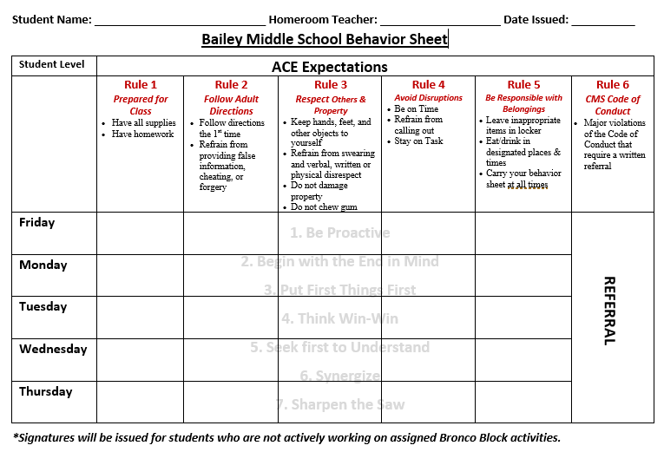

Slide 16
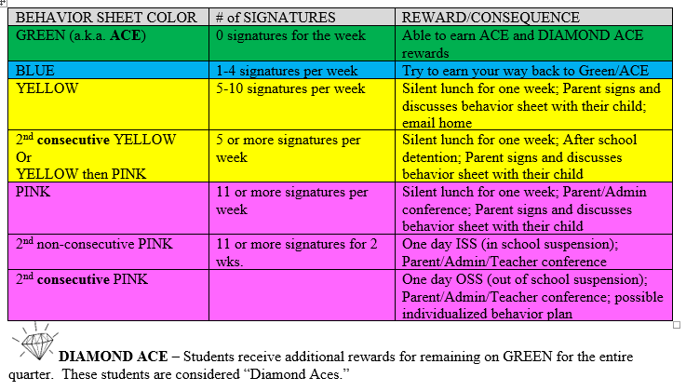

Slide 17
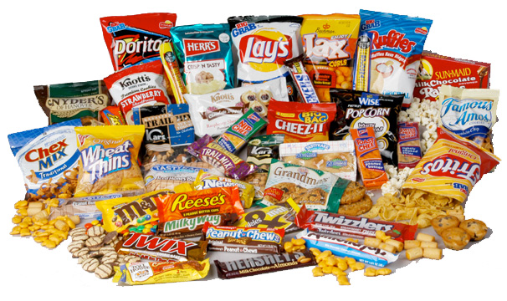
Snack?
We do NOT have snack in 6th grade so please eat a good breakfast and lunch

Slide 18
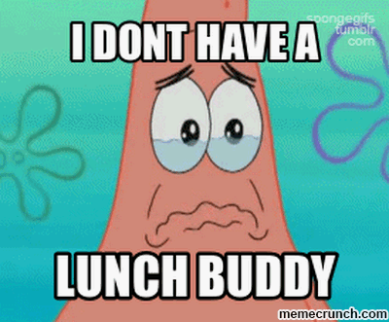
Lunch
Be kind and invite others to sit with you!
Teachers walk their students to lunch/PA
Lunch costs $2.25
You will receive your lunch card/# from your teacher
Sit at your assigned table by HOMEROOM teacher
Follow all rules and directions given by the administrators/adults on duty
Stay in a single file line at all times
You may only attend your assigned lunch and PA time
You have 20 minutes inside and 20 minutes outside
Clean your area and pick up ALL dropped trash and/or food
Each student is assigned and must complete one week of “Table Washing” per year
Use the elective restrooms during lunch (with admin permission)
There is an Allergy table in the back left corner ☺

Slide 19
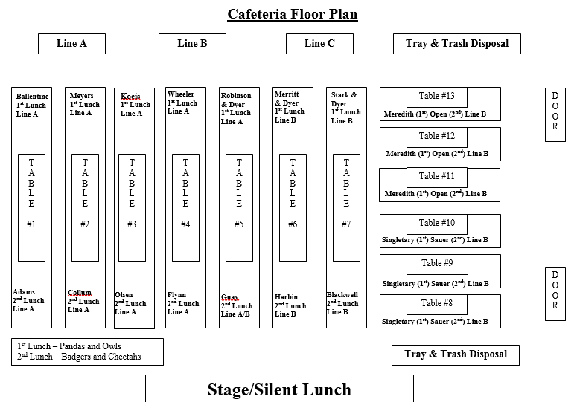

Slide 20

Silent Lunch
You are assigned silent lunch based on the number of signatures you receive.
Upon arrival to the cafeteria, wait near the water fountains for the teacher on Silent Lunch Duty. They will escort you through the line. Get everything you need because you cannot come back to the cafeteria.
You will be escorted back to a classroom where you will eat silently and work on coursework or read.
You will need to complete a “Silent Lunch Reflection Sheet” that will be turned into your grade level administrator and kept in your behavior file.
If you are disruptive during silent lunch you will receive additional consequences from your grade level administrator
Your parents are notified when you have silent lunch

Slide 21

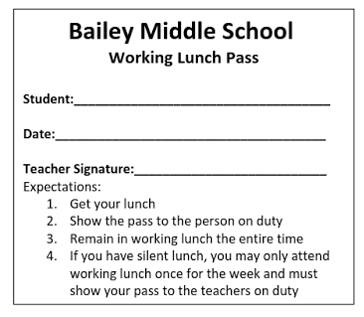
Working Lunch
Go to working lunch to get extra help, make up work when you are absent, or to retest. You MUST have a pass!
Mondays = Science
Tuesdays = Social Studies
Wednesdays = Math
Thursdays = ELA
Friday = optional

Slide 22
PA- Physical Activity
Students will have 20 min of PA daily outside (weather permitting)
Please dress appropriately to go outside (don’t forget sunscreen)
Students may play soccer, basketball, walk the track, ect.
Football is banned
The picnic tables outside are reserved for lunch students (Diamond Aces)
Students may not use their cell phones or other electronic devices during PA
When PA is over the teachers on duty will blow a whistle- this is the signal to STOP playing and line up - follow staff directions
Do NOT continue to play after the whistle is blown (basketballs will be taken away from you if you do)

Slide 23
Dismissal Procedures
Afternoon announcements will take place at 4:10 p.m.
Car riders will be called on the announcements – these students report outside the front office area. Have your parent text you when they are close to the pick-up area. Look for them and get in your car.
Late Buses will be announced daily and should report to the cafeteria. Teachers will write the late busses on their board daily. Colored signs are on the tables. Find your sign/slot and sit down. No horseplaying, games, or loud talking.
On-time buses
6th graders exit out the back of the 6th grade hall with your teacher
7th graders exit out the back of the 7th grade hall
8th graders come down the back steps (near the bus lot) and exit

Slide 24
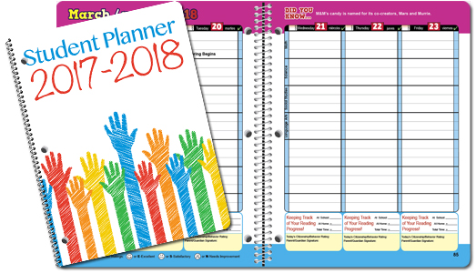
Let’s get organized…
Review your schedule and highlight your blocks for Quarter 1 (Q1) and Semester 1 (S1)
Record A/B day schedule
Record holidays
Record 7 week assessment dates
Record MAP testing dates
Record school events you want to attend
Record early release days
End of Quarter dates

Slide 25
Key Dates
2017-2018 School Calendar
First Day of School -August 28, 2017 Labor Day Holiday-September 4, 2017
Teacher Workday (s) – September 21 & 22, 2017
Last Day of Quarter 1- October 27, 2017
Teacher Workday- October 30, 2017
Veteran’s Day- November 10, 2017
Thanksgiving- November 22-24, 2017
Winter Break- December 20, 2017 -Jan. 2, 2018
MLK, Jr. Holiday- January 15, 2018
Last Day of Quarter 2- January 19, 2018
Teacher Workday- January 22, 2018
Teacher Workday- February 19, 2018
Last Day of Quarter 3- March 28, 2018
Teacher Workday- March 29, 2018
Spring Break- March 30-April 8, 2018
Memorial Day- May 28, 2018
Last Day of School- June 8, 2018
*Early Release Days for 2017-2018
(Dismiss at 1:15 pm) 10/18, 12/6, 2/7, 4/18

Slide 26
More Key Dates
7 Week Assessment Dates
Oct 16-20
6th: SC=10/16, SS=10/17, Math= 10/19, ELA=10/20
Dec. 11-15
6th: SS=12/11, Math=12/12, SC=12/13, ELA=12/14
Feb 12-16
6th: SC=2/12, SS=2/13, Math=2/14, ELA=2/15
MOCK EOG/EOC May 1-4
ELA=5/1, Math= 5/2, SC=5/3, SS=5/4
MAP Testing
Fall: Sept. 18-25
Winter: Jan. 16-19
Spring: April 9-12
Day 1 Reading, Day 2- Math, Day 3&4- Makeups
EOG Testing
May 25-June 8

Slide 27
Technology
Cell phones are to be OFF and in your LOCKER or bookbag (if you don’t have a locker).
Music may be played in class by the teacher. Students may NOT listen to music on the chromebooks or on their phones.
No BYOT - The school provides all technology devices so there is no need for you to bring technology from home.

Slide 28


Student Portal http://www.cms.k12.nc.us/Pages/StudentPortal.aspx

Slide 29
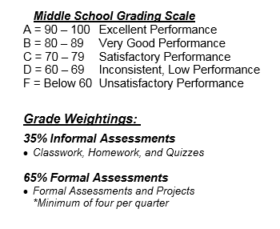
Grading Scale – Check Powerschool Weekly

Slide 30
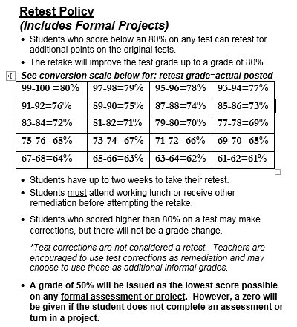

Slide 31
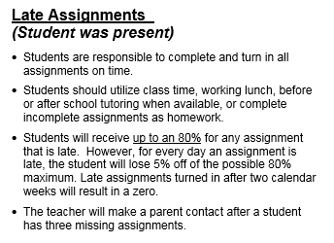

Slide 32
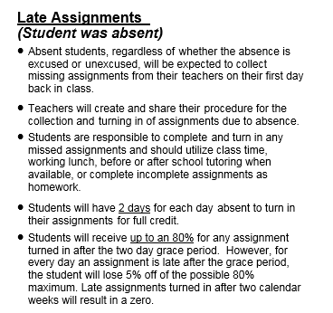

Slide 33
Honor Code – Review fully with students
HONOR STATEMENT
"On my honor I have neither given nor received unauthorized assistance or information on this assignment. I have followed and will continue to follow the Honor Code and I am unaware of any violation of the Honor Code by others. This work is the sole result of my own effort."
Signing of the pledge implies a student’s commitment to uphold the principles and rules outlined in the Bailey Honor Code. All students must sign the Academic Honor Code and pledge form. A copy is kept in their permanent files in the grade level administrator’s office. Each time students place their name on exams, papers, labs, tests, quizzes, projects, homework, and other academic work, they acknowledge their responsibility and commitment to the Academic Honor Code. In addition to discipline consequences, students who violate the Honor Code may be ineligible for athletics, honor societies, student government, club participation, and/or other activities.

Slide 34

Discipline
Review the Code of Student Conduct with students
Students receiving ISS or OSS for violations of the CMS Code of Conduct or are absent from school cannot attend or participate in any after school events that day. (Ex. No dances, sporting events, field trips, etc.)

Slide 35
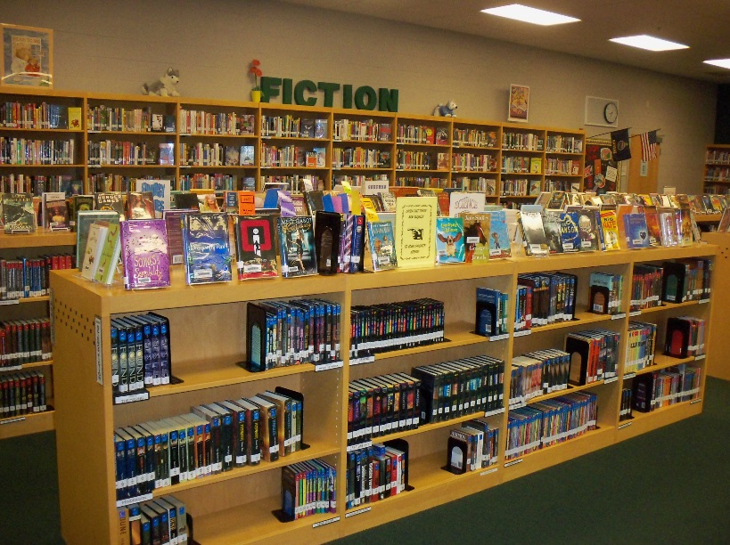
Media Center
Hours and Usage: Students can visit the media center regularly. Students are welcome to use the media center, with teacher permission, any time of the school day for pleasure reading, research, or other school requirements. The media center will sometimes be open after school for work on classroom assignments. These times will be announced to students in advance.
You will be taken to the media center as a class to check out a book(s)

Slide 36



Bronco Block
Bronco Block is used for Enrichment, Remediation, and Clubs
You will attend Bronco Block Monday-Thursday
Students in a club must be passing their CORE classes (ELA, Math, Science, Social Studies)
Poor academics and/or behavior will disqualify you from participating
Work on IXL, Compass Learning, Silent Reading, Homework, or work with the teacher in a small group

Slide 37










Clubs
Bailey Dance Company
Step Team
STEM
Leadership Ambassadors
Code Academy
Drama/Scenery Club
Future Business Leaders of America (FBLA)
Odyssey of the Mind
Chess Club
Robotics
Bailey Gives Back
WBAM Student Television

Slide 38

Athletics
Eligibility is based on academics and behavior. Visit the school’s website for schedules, try-out information, and forms.
Fall Sports
Football, Volleyball, Cheerleading, Softball, Golf
Winter Sports
Girls and Boys Basketball, Cheerleading
Spring Sports
Boys and Girls Track & Field, Boys and Girls Soccer, Baseball

Slide 39



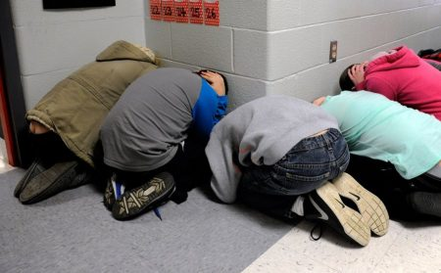
School Safety
We will do monthly drills. Students need to be quiet and listen to instruction from their teachers during ALL safety drills! Students should take all drills seriously. Follow teacher directions.
Fire drill
Line Up quietly at the door and follow your teacher out to your designated outside location
Tornado
Students will line up in the hallway along lockers away from windows and doors
Duck and cover head
Lockdowns
NO TALKING
Students will be moved to a safe location
Teacher will lockdown room (windows covered, doors locked, students out of harms way)
NEVER open the door after it is locked and hallway swept!!!

Slide 40
Evacuation Routes

Slide 41
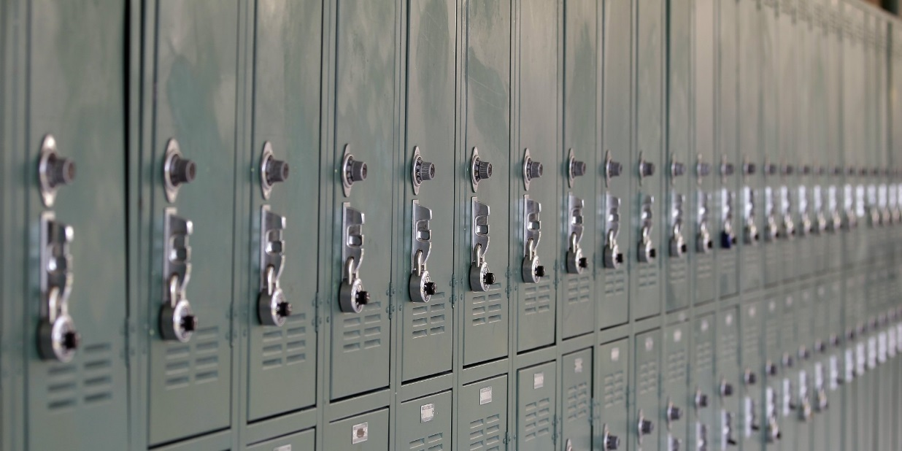
Lockers
You are responsible for all items in your locker!
Keep your locker closed with the lock LOCKED – this will keep your items safe
We do random locker searches throughout the year with the CMS drug dogs
There should be no more than 2 people per locker
Practice opening and closing your lock so you can be on time to class

Slide 42


Birthdays/Decorations
Birthday parties, cake, and/or balloons of any kind are not permitted at school.
In addition, students are not permitted to decorate the outside of lockers for birthdays or other special events.

Slide 43
We are here when you need us ☺
Mrs. Fitzpatrick, 6th grade Assistant Principal
norma.Fitzpatrick@cms.k12.nc.us
Mrs. Litchfield, 6th grade Counselor
kristend.Lavoie@cms.k12.nc.us

Slide 44

Questions?
Just ask! No questions are silly!

